Slide 1
Build Mixed Reality Apps
Notes:
DEMOS: https://github.com/Microsoft/InsiderDevTour18-MR
SETUP / AWARENESS
Be sure to test video out and audio with the final settings as some AV systems have issues displaying this type of content

Slide 2
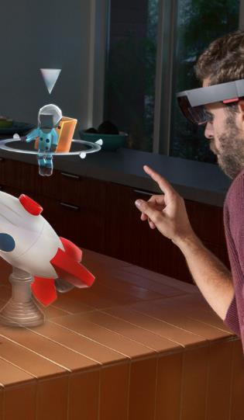
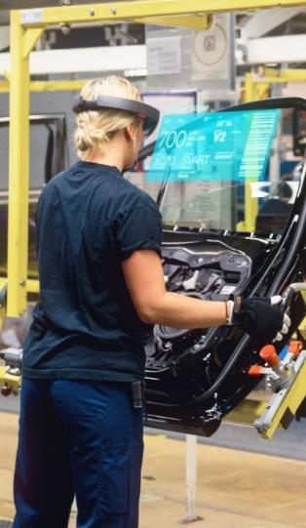

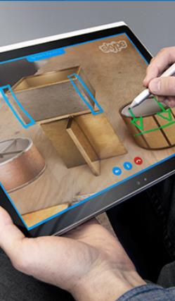
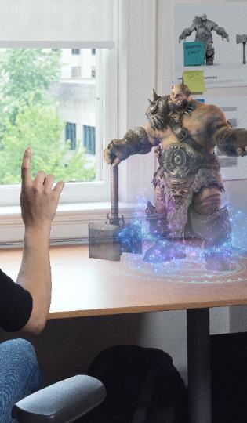
The Era of Mixed Reality
Creation & Design
Assembly & Manufacturing
Training & Development
Communication & Understanding
Entertainment & Engagement
Notes:
Personalize the opening..
Approach #1
We are now going to talk about Mixed Reality.. To me, this is a super fun and exciting session because I grew up dreaming of living in a world with mixed reality..
Watching movies like terminator with the Heads-up display.. Or minority report, with virtual, endless desktops that you could navigate with your gaze and your hands..
Those scenarios are now possible. We are still early, we might not use them in every day life, but MR is already disrupting industries..
Click!
Examples:
Here is some examples of how you could be using Mixed Reality today:
Creation and design – the ability to see and manipulate 3D designs in real time, in a real world setting, at true size and scale.
Assembly and manufacturing – the ability to synthesize complex data sets and provide visual displays that aid in navigation and operations.
Training and development – the ability to explain complex scenarios visually, with movement and in three dimensions.
Communication and understanding – the ability to provide remote expert assistance. Seeing through the eyes of a remote user and provide annotations that appear as holographic content through HoloLens.
Entertainment and engagement – the ability to experience entertainment content in more personal and immersive ways.

Slide 3

Notes:
Last year, Microsoft took the award winning Inside Out tracking for Hololens and licensed it to OEMS, and now we have also occluded (or virtual reality headsets). Let me show you a quick video that demos the kind of experiences you can create and the benefits of our headsets.

Slide 4
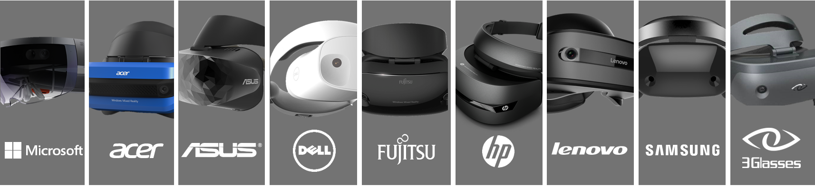
Windows Mixed Reality Headsets
Notes:
Here are the headsets, in case you want to remember the OEMs.. As you an see, there is lots of OEMs, world-wide coverage. A great developer opportunity.
Personalize it, if possible:
I love the Acer because it is light and the flip feature provides me great productivity during development.. That said, the Samsung has an amazing quality. It was launched last year and has a very high quality display..

Slide 5
Building your first Mixed Reality App
Notes:
We are done with the intro.. From here on it is code ;)
A hands-on, code heavy demonstration on building our first MR app(s).. .

Slide 6

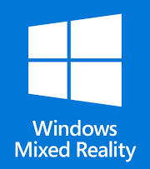


Software for today’s session…
Notes:
For today, we are going to use Unity and Visual Studio to build our Mixed Reality app.
Unity is the most popular 3d engine for Virtual and Augmented reality, so everything you learn today is applicable to apps you could write for other platforms like SteamVR, or Oculus Rift.
Our app will span across the Mixed Reality continuum. We will start with Virtual Reality on this headset and then move to Augmented reality with hololens. It is all one code base, one scene even.
We will used the Mixed Reality toolkit to jumpstart or accelerate our development.. If you are familiar with other toolkits like MRTK or NewtonVR, you can use those too. They support WinMR already.
Today, we are using MRTK because that maximizes reuse with Hololens.

Slide 7
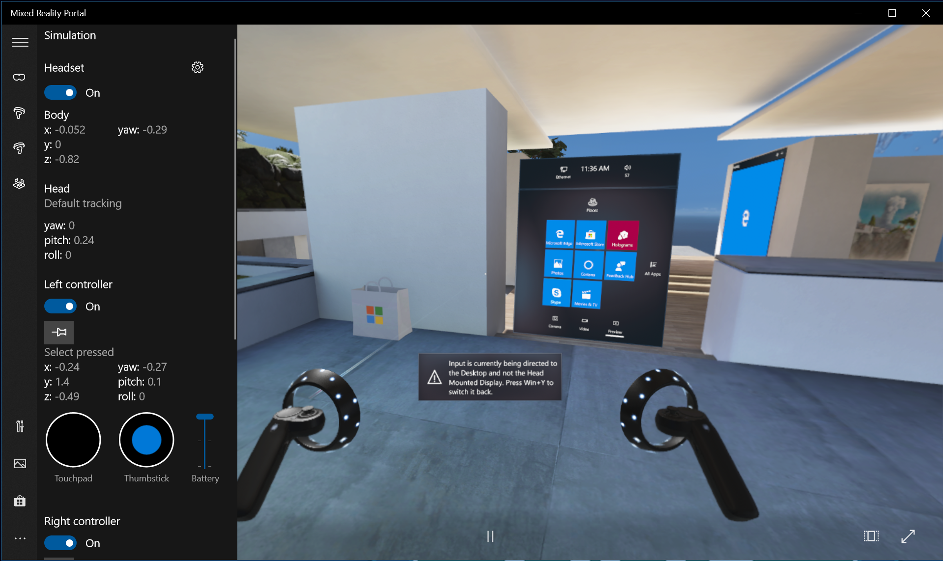
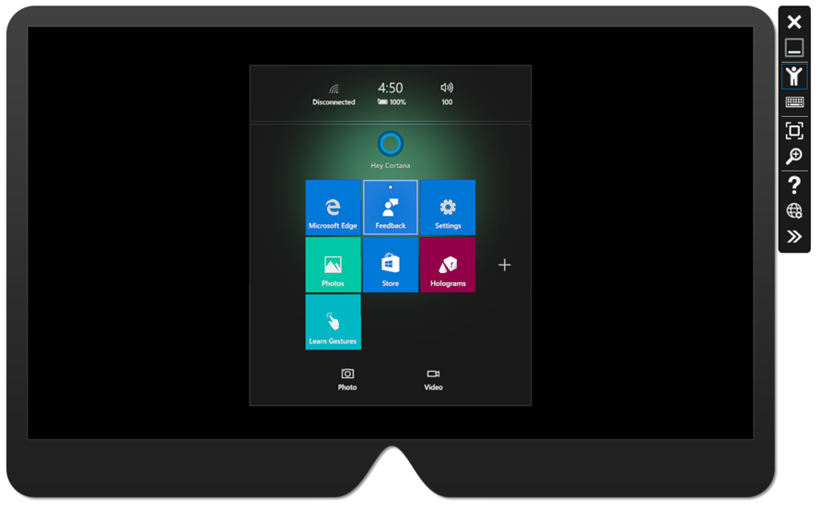
Emulators
Windows Mixed Reality Portal
Hololens Emulator
https://aka.ms/iwantmr to nominate an idea/app to port and get an immersive headset
Notes:
I won’t be showing using these today, but I do want to give a shout to our emulators.
If you do not have a hololens device or a VR headset, you can use the emulators and still develop the apps.
They are very feature rich with simulating input, controller, and headset orientation…
Click..
If you have a great idea, start with the emulator and once you have your concept fleshed out, go to https://aka.ms/iwantmr and nominate your idea for our early porting program. They can give you a free immersive headset, controllers, and access to great help to ship an app ..

Slide 8
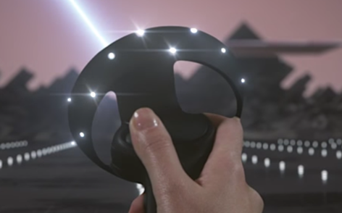
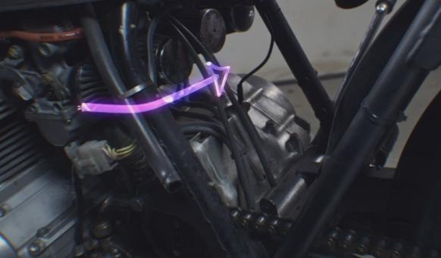
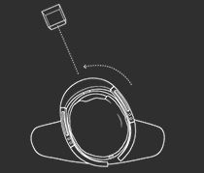
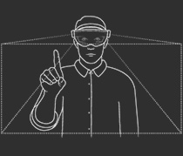
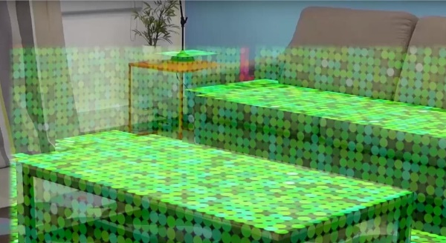
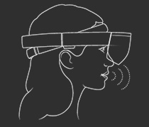

Building blocks...
World coordinates
Gaze
Controllers
Gesture
Spatial mapping
Voice commands
Spatial sound
Notes:
To write any Mixed Reality apps there is a core set of building blocks at our disposal. In this session we are going to cover these core building blocks.
===extra context for reference. Not for delivery === You will need to know about 3d objects and world coordinates to interact with the space or for your immersive experience.
We will select an input mechanic like gestures or controllers based on the device and type of experience you are creating. .
On Windows experiences, you can also use Voice input. Windows emphasizes it a little more and it is more common.
On some devices like Hololens or iPhones running ARKit, you can also implement Spatial mapping or spatial understanding.. To map the environment that you are in and interact with the shell.

Slide 9
3D and Spatial Coordinates
Precisely positioning and orienting the user in the right place, relative to the other objects elements within the scene.
Notes:
We live in a 3D world.. There fore as we talk about augmenting our world, or transporting ourselves to a different world, we will need to discuss 3d coordinate systems and different space types..
==== For reference only ============
Useful for speaker: https://developer.microsoft.com/en-us/windows/mixed-reality/coordinate_systems
At their core, holographic apps place holograms in your world that look and sound like real objects. This involves precisely positioning and orienting those holograms at places in the world that are meaningful to the user. When reasoning about the position and orientation of your holograms, or any other geometry such as the gaze ray or hand positions, HoloLens uses various coordinate systems to represent that geometry.
1 Spatial coordinate systems
2 Stationary frame of reference
3 Spatial anchors
3.1 Why a single rigid coordinate system cannot be used for the whole scene
3.2 The solution: Spatial anchors
3.3 Spatial anchor persistence
3.4 Spatial anchor sharing
3.5 Best practices
4 Attached frame of reference
5 Head-locked content
6 Handling tracking errors
6.1 Device cannot track due to insufficient sensor data
6.2 Device tracks incorrectly due to dynamic changes in the environment
6.3 Device tracks incorrectly because the environment has changed significantly over time
6.4 Device tracks incorrectly due to identical spaces in an environment

Slide 10
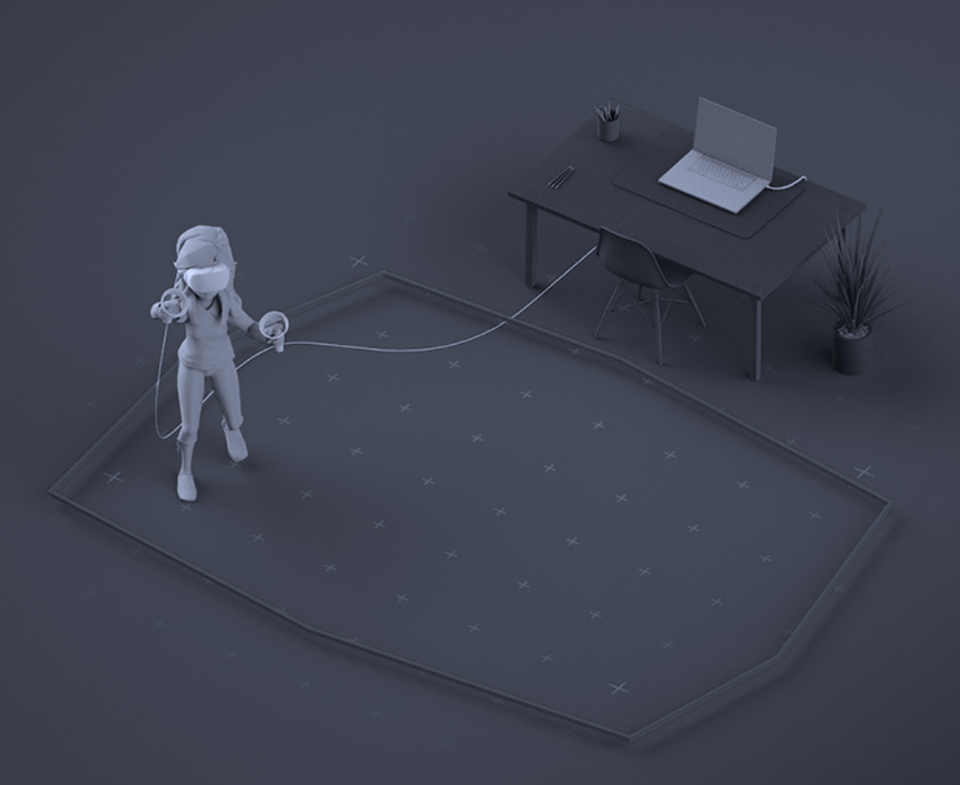
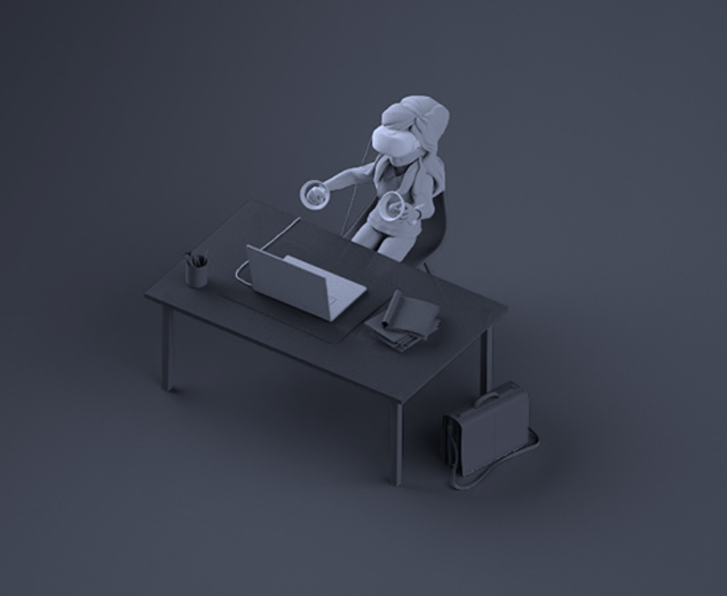
Space Types
Roomscale
Stationary
Origin is center of room
Can’t Recenter()
Origin is headset upon start
Can Recenter()
Notes:
There are two different types of space types across VR apps: Roomscale or Stationary..
On roomscale, the origin is the center of the room, and you can’t change that or Recenter the scene.
With stationary (also known as seated), the origin is the place that the headset is at, when the user last Recentered (or when scene is launched since that is first recenter)..
So, with stationary.. 0,0,0 is right here, at my eye level.. Where in the physical world, even if I was standing on the center of the room, my Y would be 1.5 meters or so..
There fore there is an extension to stationary, we refer to as standing.. In this setup, you use stationary but offset your floor..

Slide 11
Demo!
Creating Mixed Reality app w/Unity
Notes:
Now that we know how to setup our space, lets create our virtual room and setup our project to target Windows Mixed Reality.
See detailed click through notes:
Create empty Unity project
Drag a Prefab object into the scene.
Reset the camera.
Export to Mixed Reality.
Explain Generated Visual Studio solution. Have one pre-built.

Slide 12
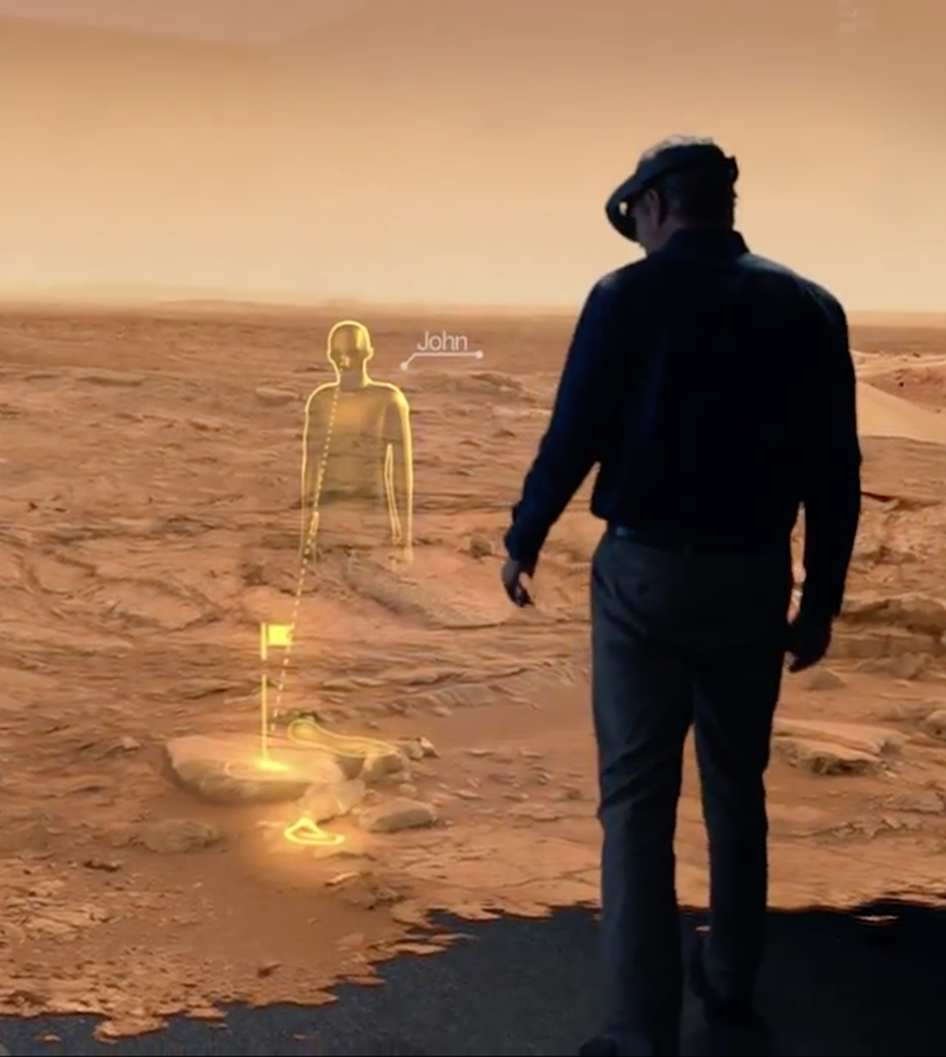
Gaze
Gaze tells you where the user is looking in the world and lets you determine their intent
Notes:
In the real world, you'll typically look at an object that you intend to interact with.
Mixed Reality headsets use the position and orientation of your user's head, not their eyes, to determine their gaze vector. You can think of this gaze vector as a laser pointer straight ahead from directly between the user's eyes. As the user looks around the room, your application can intersect this ray, both with virtual objects or real-world objects (discovered via Spatial Mapping) .
If you will use Gaze, you should have a cursor (or other auditory/visual indication) to give the user confidence in what they're about to interact with. You typically position this cursor in the world where their gaze ray first interacts an object, which may be a hologram or a real-world surface.
With that, let’s go ahead and add gaze and a cursor to our app.
==
Pre-read for speaker: https://developer.microsoft.com/en-us/windows/mixed-reality/gaze

Slide 13
Demo!
Gaze
Notes:
See detailed click through notes:

Slide 14
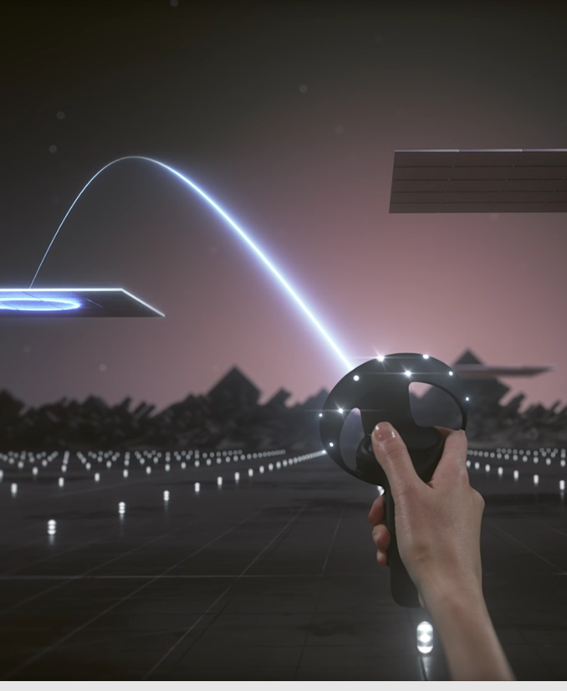
Motion controllers
Track the position of the user’s hands in space
Enable fine grained interactions with digital objects
Notes:
Motion controllers allow us to take action in mixed reality.
With controllers we can track the position of our hands in space, and we can get fine grained interaction with digital objects.
There is a lot of power behind motion controllers.. I can use a thumbstick to move forward, or to rotate say 30 degrees on any direction.. There is a lot of buttons that I can configure for different actions..
=====

Slide 15
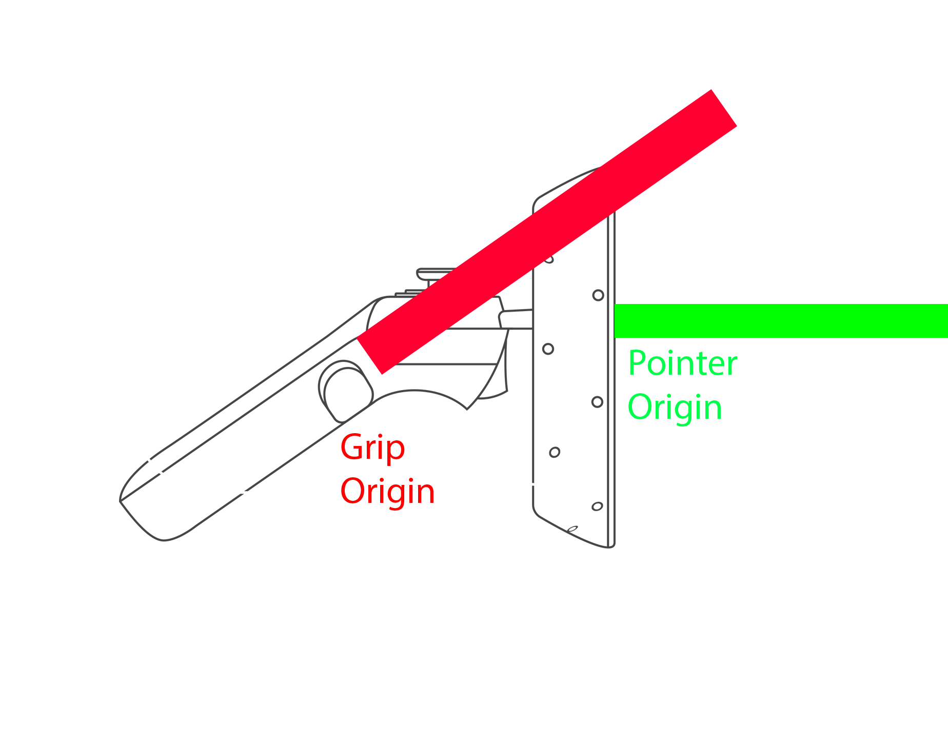
UnityEngine.XR.WSA.Input APIs
InteractionManager
InteractionSourceState
GetCurrentReading()
+InteractionSourceDetected
+interactionSourceUpdated
+interactionSourceReleased
+interactionSourcePressed
headPose
source
selectPressed & selectPressedAmount
menuPressed
touchPadPressed
touchPadPosition
thumbstickPressed
headRay
….
sourcePose
Notes:
To handle motion controller input, you can use Unity’s generic Open VR input system..
Or, when targeting Microsoft Mixed Reality experiences, you can use the new UnityEngine.XR.WSA APIs.
These APIs are strong typed and have more level of detail than the Openvr APIs do. Where they have more detail is because the UWP platform exposes two different poses for controllers. There is a pose for “Pointer” where the center is right here, where the pointer begins… and there is a pose for “Grip” where the center is right here, where our hands grip the controller As you can imagine, the pointer pose is great for when you are pointing to an object.. Specially when you render the controller model and use that to point..
The grip pose is best for when you are holding or throwing an object and you want your origin to be the grip where you hold the control..
So, with that, lets go ahead and add motion controllers to our scene.

Slide 16
Demo!
Motion Controllers
Notes:
Let’s now add controllers to our scene..

Slide 17
Building blocks
World coordinates
Gaze
Controllers
Gesture
Spatial mapping
Voice commands
Spatial sound
Notes:
To write any Mixed Reality apps there is a core set of building blocks at our disposal. In this session we are going to cover these core building blocks.
===extra context for reference. Not for delivery === You will need to know about 3d objects and world coordinates to interact with the space or for your immersive experience.
We will select an input mechanic like gestures or controllers based on the device and type of experience you are creating. .
On Windows experiences, you can also use Voice input. Windows emphasizes it a little more and it is more common.
On some devices like Hololens or iPhones running ARKit, you can also implement Spatial mapping or spatial understanding.. To map the environment that you are in and interact with the shell.

Slide 18
Demo!
Augmented Reality with Gestures, Voice and Spatial Mapping

Slide 19
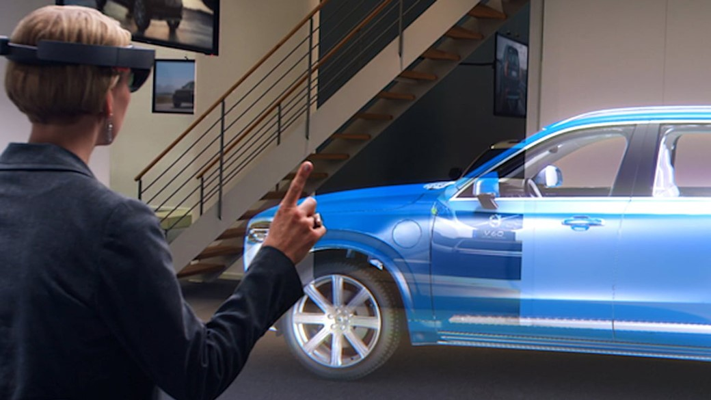
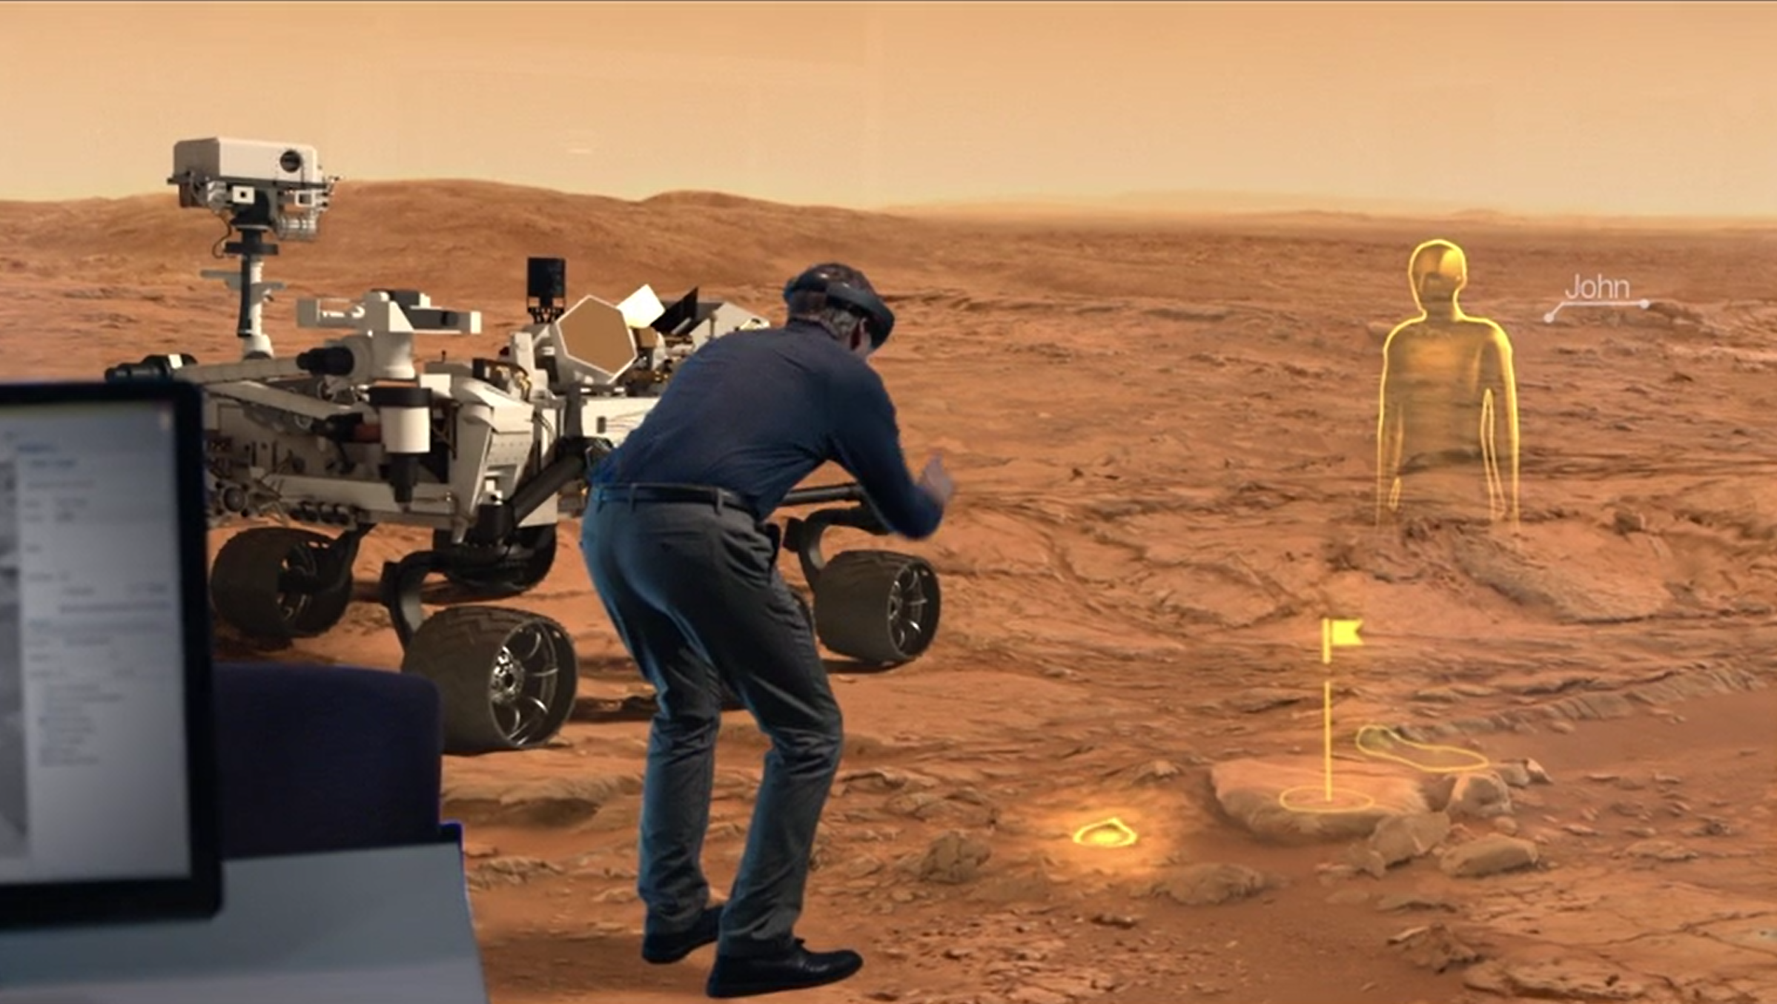
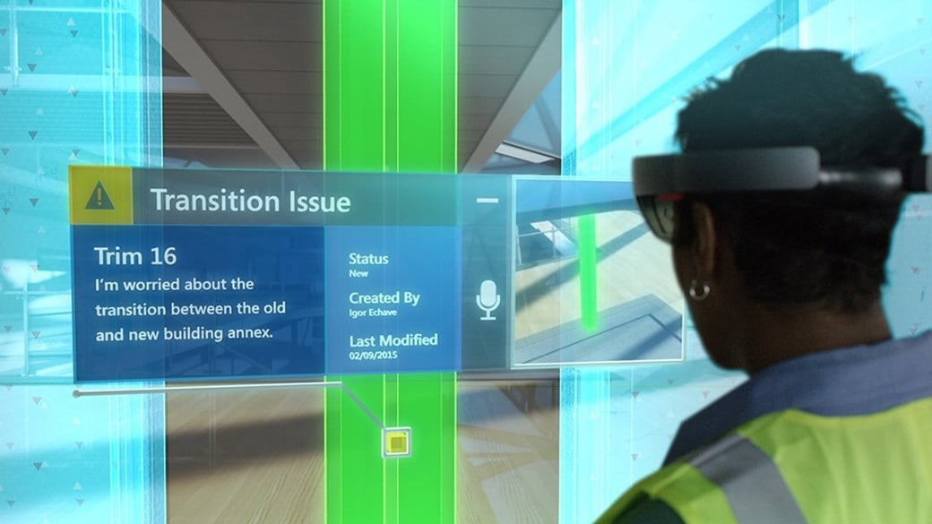





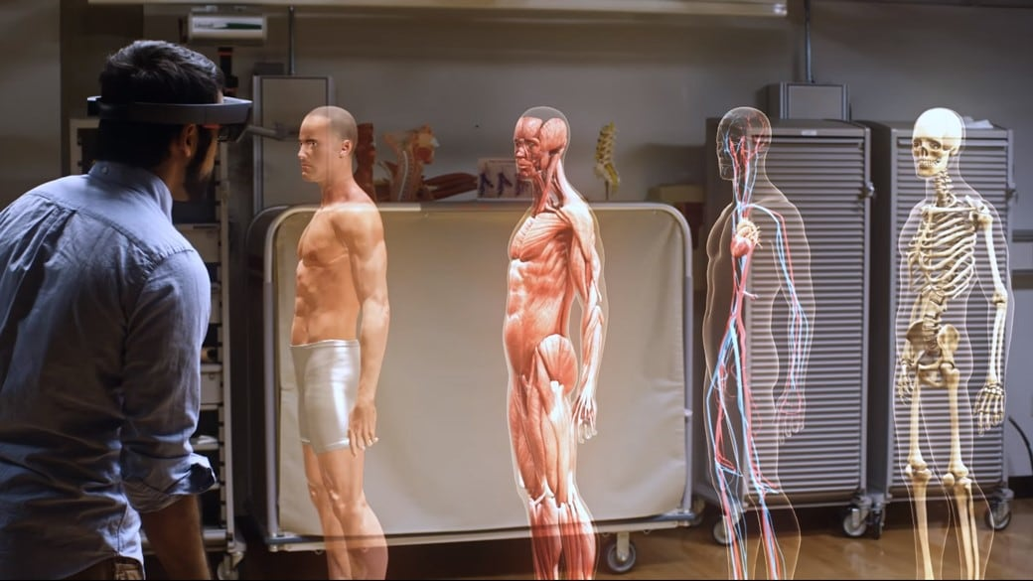
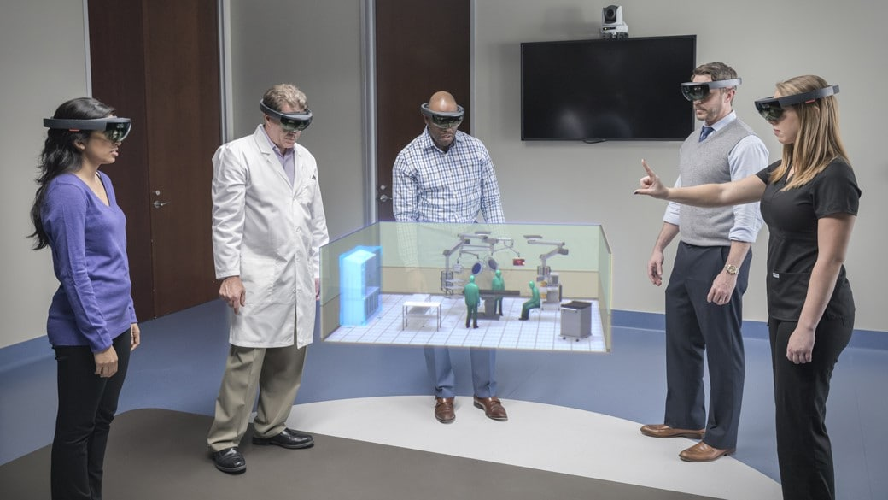
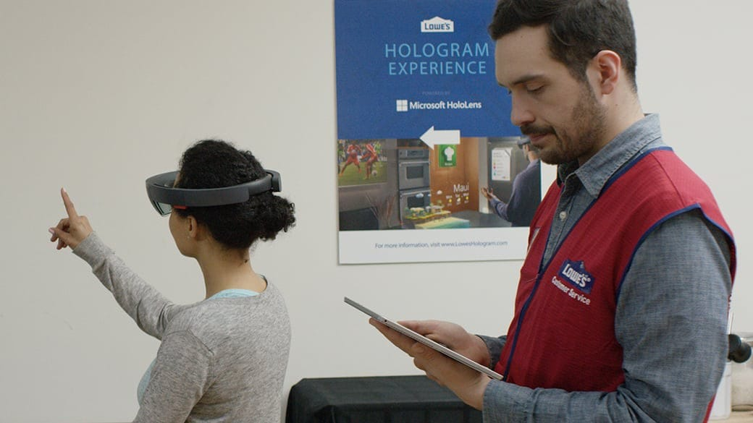



Mixed Reality is transforming industries
https://www.microsoft.com/en-us/hololens/commercial-overview
Manufacturing & Aerospace
Public Sector / Government
A, E, & C
Education
Healthcare
Retail
Notes:
[NOTE]
This slide is more effective if you walk them through the webpage at https://www.microsoft.com/en-us/hololens/commercial-overview
============
We began today our session today discussing how MR is transforming industries so I want to invite you to the hololens case studies site, get some inspiration from industry leaders that are embracing mixed reality already..

Slide 20
aka.ms/insiderdevtour-labs
Export a Unity project
Create a scene
Add Controller support, gestures & teleporting
Add spatial sound
Target HoloLens and immersive headset
Notes:
I also want to invite you to do the hands-on lab.
Everything you saw me do, you can practice on your own in a more interesting scenario, as an audio engineer identifying the best place to put speakers in a room..
Remember, even if you don’t have a device, you can do these in the simulator.

